Slide 1
Sensing and Perception Vision Sensors
Manfred Huber
Fall 2019

Slide 2
Proximity Sensors
Proximity / Distance sensors such as Sonar, Laser Ranger, LADAR, etc. are good at:
Determining the presence of an obstacle / object
Measuring the distance to this obstacle
Forming a map of the surrounding environment in terms of occupied space at a fixed level
They have problems with:
Identifying the object
Differentiating multiple objects
Mapping in full 3D (need to tilt the sensor)

Slide 3
Machine Vision
Machine vision uses a passive sensor to detect and identify an object
Cameras detect objects with no need to transmit a signal
Hard to detect by a third party
Multiple cameras can be used without interference
Machine vision requires significant amounts of computer processing to extract information

Slide 4
Machine Vision
By identifying and classifying groups of pixels as an obstacle, machine vision can be used to generate information that supports path planning or opportunistic motion behaviors.
Vision with a single camera usually requires assumptions about the terrain to work

Slide 5
Machine Vision
Many ways to process images or video have been developed
A common processing sequence to identify an object (object recognition) involves
“Box”
Filtering
Segmentation
Recognition
Feature
Detection
Early Vision

Slide 6
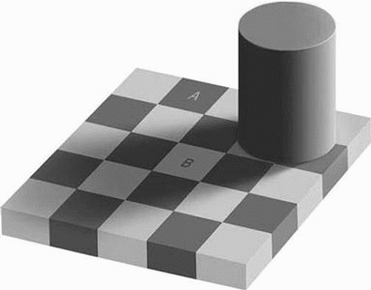
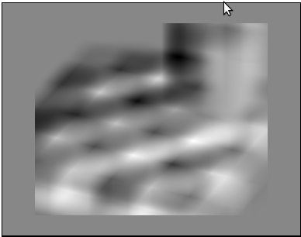
Machine Vision
Filtering:
Remove noise, normalize, and emphasize the image
Feature Detection:
Extract significant local structures
Edges, Color, Texture, Motion, …
Segmentation:
Group features into regions belonging to a common object
Recognition:
Determine identity of the object

Slide 7
Machine Vision
Common example for simple color-based object extraction:
Filtering:
Blur image to reduce noise in individual pixels
Feature Detection:
Identify pixels that are within a given color range
Results in a black and white feature map
Segmentation:
Blob coloring to link neighboring pixels in the same color range

Slide 8
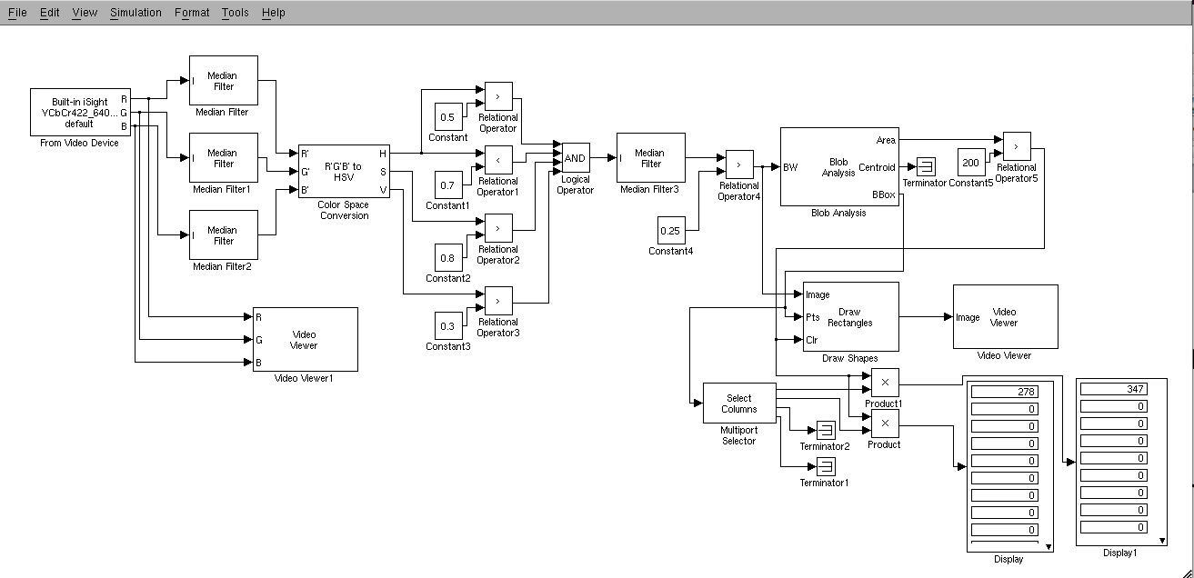
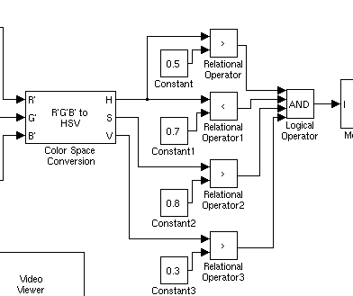
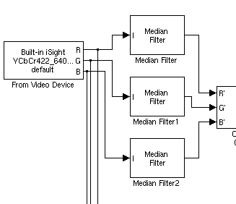
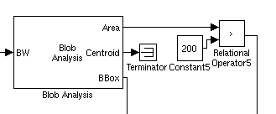
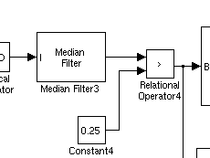
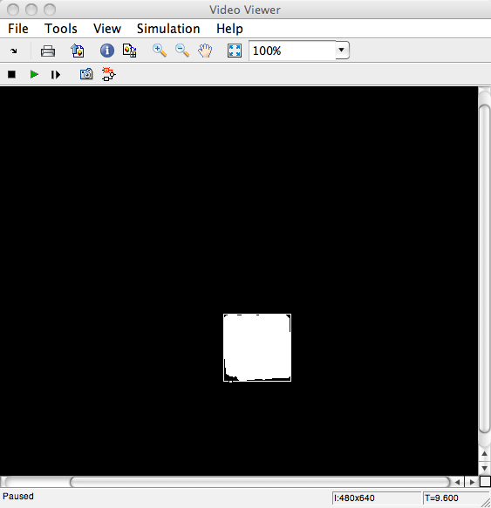
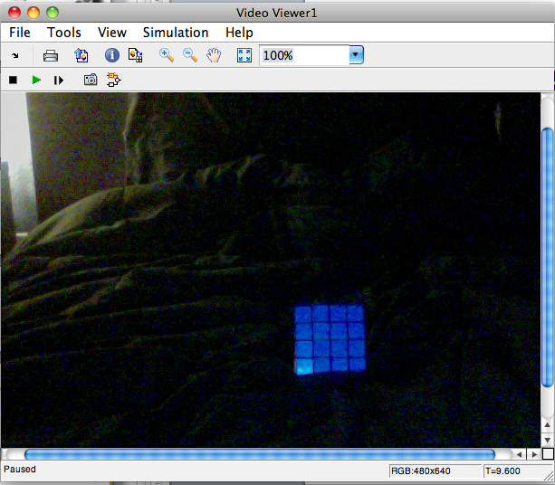
Color-Based Object Extraction in Simulink
Region Segmentation
Result Blurring
Image Blurring
Color Extraction

Slide 9
Simulink Model Demonstration

Slide 10
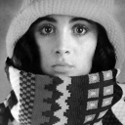

Machine Vision
Convolution is one of the most common filtering and feature detection methods
Cross-correlation computes the “similarity” between a local image region and a template
Convolution computes cross-correlation (the sum of the product of the corresponding template and image pixels) for each template location
112
85
112
112
85
112
85
1/9 | 1/9 | 1/9
1/9 | 1/9 | 1/9
1/9 | 1/9 | 1/9
0 | 0 | 0 | 0 | 0 | 0 | 0
0 | 255 | 255 | 255 | 255 | 255 | 0
0 | 255 | 0 | 0 | 0 | 255 | 0
0 | 255 | 0 | 0 | 0 | 255 | 0
0 | 255 | 0 | 0 | 0 | 255 | 0
0 | 255 | 255 | 255 | 255 | 255 | 0
0 | 0 | 0 | 0 | 0 | 0 | 0
85 112 112
85 0 85 85
112 85 112 112
85 112 85 112 85

Slide 11



Machine Vision
Edge Detectors:
Roberts Templates:
Sobel Templates:
0 | 1
-1 | 0
1 | 0
0 | -1
1 | 0 | -1
2 | 0 | -2
1 | 0 | -1
1 | 2 | 1
0 | 0 | 0
-1 | -2 | -1
2 | 1 | 0
1 | 0 | -1
0 | -1 | -2
0 | 1 | 2
-1 | 0 | 1
-2 | -1 | 0

Slide 12
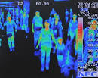
Machine Vision
To extend the capabilities of vision, multiple special purpose types of cameras exist:
Visual light cameras
Near infrared cameras
Heat cameras

Slide 13
Heat Camera Demonstration

Slide 14
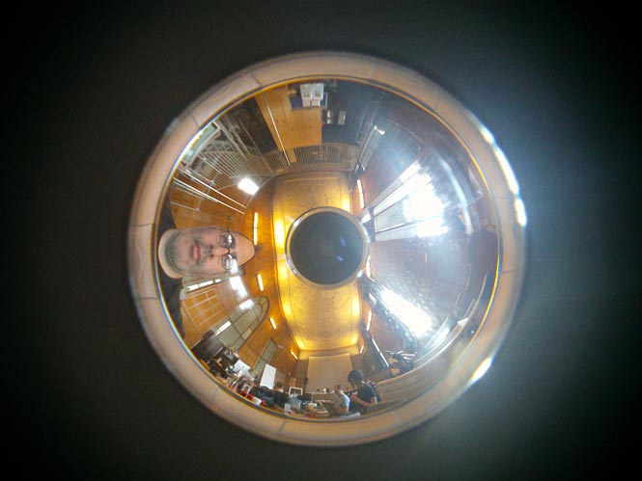
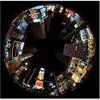
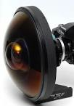
Machine Vision
Unusual optics to change field of view and perspective
Super fisheye lenses for 185 degree field of view
Panoramic lenses for view in all direction

Slide 15
PAL Lens Demonstration

Slide 16
Machine Vision
Machine vision with a single camera has a number of advantages over other sensors:
Images contain large amounts of information
Object identity and behavior can be extracted
But single camera vision has also significant problems:
Extraction of objects is very difficult
Determination of distance requires assumptions
Size is known
Terrain is known

Slide 17
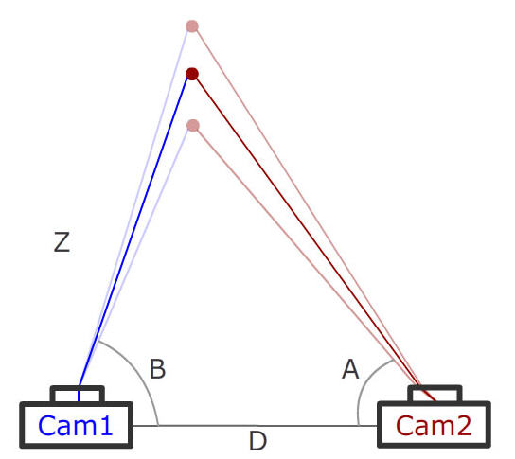
Stereo Vision
Stereo vision allows to determine distance to an object using triangulation
Need to solve the correspondence problem
Identify the same feature in both images
Compute angles from the cameras to the feature
Triangulate location
Compute distance

Slide 18

Stereo Vision
The correspondence problem is in general not tractable (or even not solvable)
Need either better algorithms or other methods to apply this on UxVs
Even humans fall prey to the correspondence problem:
E.g. Stereograms
Computers without additional information are prone to make many mistakes

Slide 19
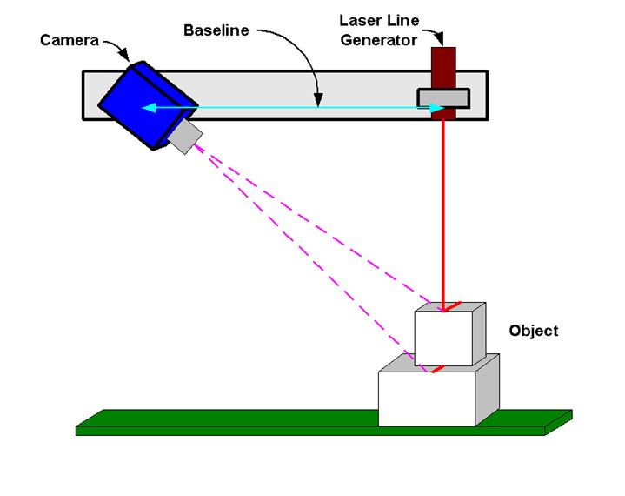
Structured Light Sensors
Structured light is one way to address the correspondence problem
Replacing one camera with a pattern generator means:
Pattern location in one camera is known
Pattern is easier to find in the other camera
Laser striping is the simples form of structured light sensors

Slide 20
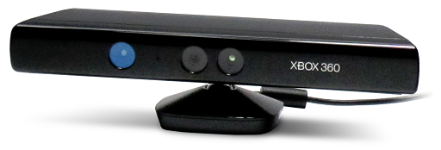
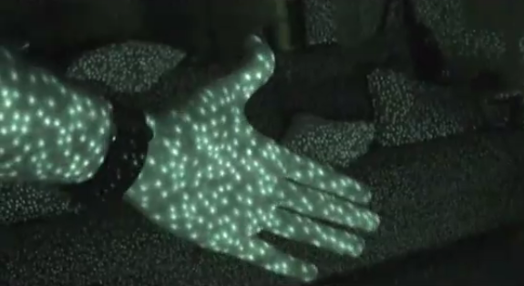
Structured Light Sensors
Laser striping is limited to a very small number of lines to avoid the re-occurrence of the correspondence problem
More complex, non-repetitive patterns can address this: E.g.: Microsoft Kinect 360
Project a known, non-repeating pattern
Identify region patches in the image
Determine distance

Slide 21
ASTRA Demonstration

Slide 22
Structured Light Sensors
Structured light sensors require reliable identification of the projected pattern
Pattern is difficult to find in bright conditions
Distance can only be determined at the pattern-level (not at the pixel-level)
Structured light is generally limited in resolution and in terms of the environments in which it can be used

Slide 23

Time-Of-Flight Cameras
Time-of-flight cameras compute the distance of a part of the object by measuring the time it takes for light to travel from a light source to the individual pixel
Objects
Emit modulated light near lens
Modulation changes intensity at a rate of around 15-30 MHZ
Compute time-of-flight based on phase shift in modulation
Eliminates the need to measure at 1/100 nanoseconds resolution
Modulated
Illuminator
TOF
Camera
Phase Shift
Calculation

Slide 24
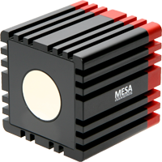
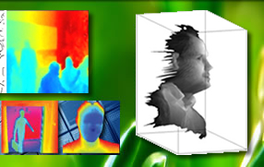

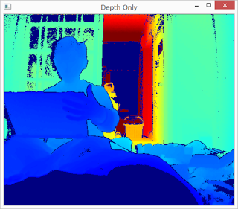
Time-Of-Flight Cameras
Time-of-flight cameras have recently become available
Swiss Ranger
Kinect One

Slide 25
Swiss Ranger Demonstration

Slide 26
Machine Vision
Different vision sensors are best for different applications
Choice of wavelength and lenses can be important parts when deciding what vision sensors to put on a UxV
While structured light and TOF systems are no longer passive, they make computing distance significantly easier
Have to decide the tradeoff in terms of visibility and sensitivity to change in lighting
Identification of the object is a very difficult problem and in general not tractable

Slide 27
Machine Vision
While vision sensors are an important sensor modality that provides information that is not available from other sensors, it is not a replacement
Proximity / range sensors like LADAR are usually faster to evaluate and sufficient for collision avoidance
Vision can be fooled by transparent surfaces and ones without easily discernable features
Inclusion of vision is a significant commitment in terms of image processing algorithm development

